Slide 1
Lecture 2 Conditional Probability

Slide 2
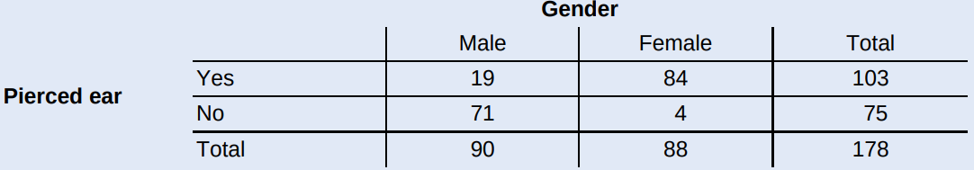

Students in a college statistics class wanted to find out how common it is for young adults to have their ears pierced. They recorded data on two variables—gender and whether or not the student had a pierced ear—for all 178 people in the class. The two-way table summarizes the data
Suppose we choose a student from the class at random. Define event A as getting a male student and event B as getting a student with a pierced ear.
Find P(B).
Find P(A and B). Interpret this value in context.
Find P(A or B).

Slide 3
Students in a college statistics class wanted to find out how common it is for young adults to have their ears pierced. They recorded data on two variables—gender and whether or not the student had a pierced ear—for all 178 people in the class. The two-way table summarizes the data
Suppose we choose a student from the class at random. Define event A as getting a male student and event B as getting a student with a pierced ear.
b. Find P(A and B). Interpret this value in context.
There’s about an 11% chance that a randomly selected student from this class is male and has a pierced ear.
Notes:
A male student with pierced ear

Slide 4
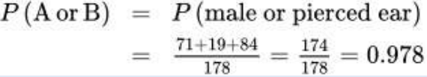
Students in a college statistics class wanted to find out how common it is for young adults to have their ears pierced. They recorded data on two variables—gender and whether or not the student had a pierced ear—for all 178 people in the class. The two-way table summarizes the data
Suppose we choose a student from the class at random. Define event A as getting a male student and event B as getting a student with a pierced ear.
c. Find P(A or B).
Notes:
The student is male or the student had a pierced ear

Slide 5
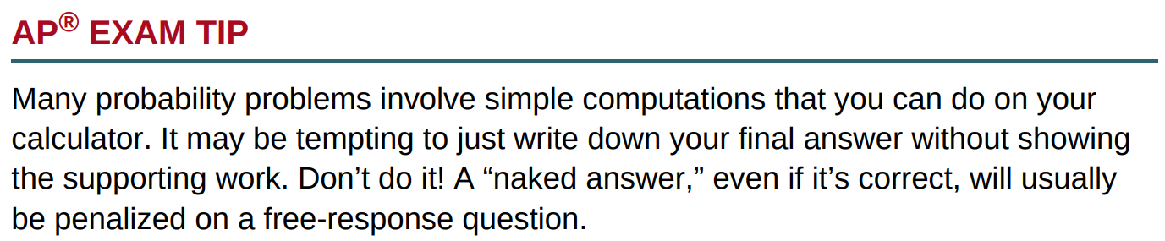
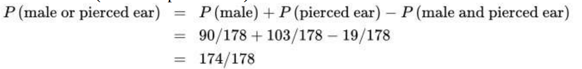
Students in a college statistics class wanted to find out how common it is for young adults to have their ears pierced. They recorded data on two variables—gender and whether or not the student had a pierced ear—for all 178 people in the class. The two-way table summarizes the data
Suppose we choose a student from the class at random. Define event A as getting a male student and event B as getting a student with a pierced ear.
c. Find P(A or B).

Slide 6
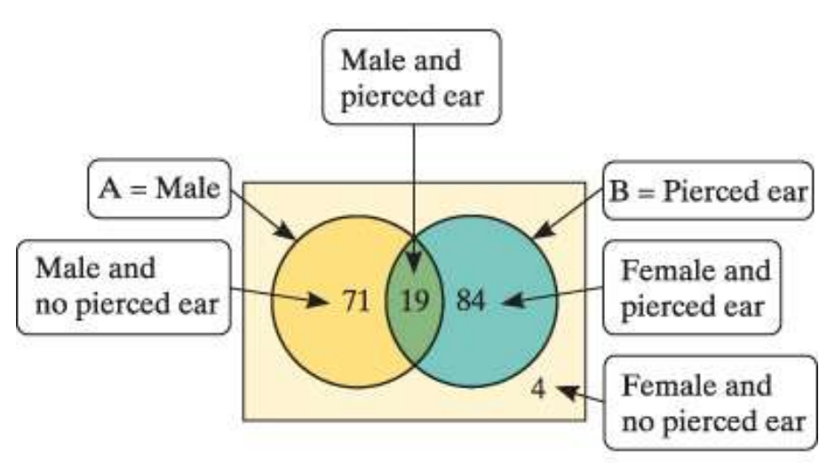

Slide 7
If we know that a randomly selected student has a pierced ear, what is the probability that the student is male?

Slide 8
If we know that a randomly selected student is male, what’s the probability that the student has a pierced ear?
Notes:
这些就叫做conditional Probability
那我们观察一下我们是怎么计算的：
分子：pierced and male
分母： male

Slide 9
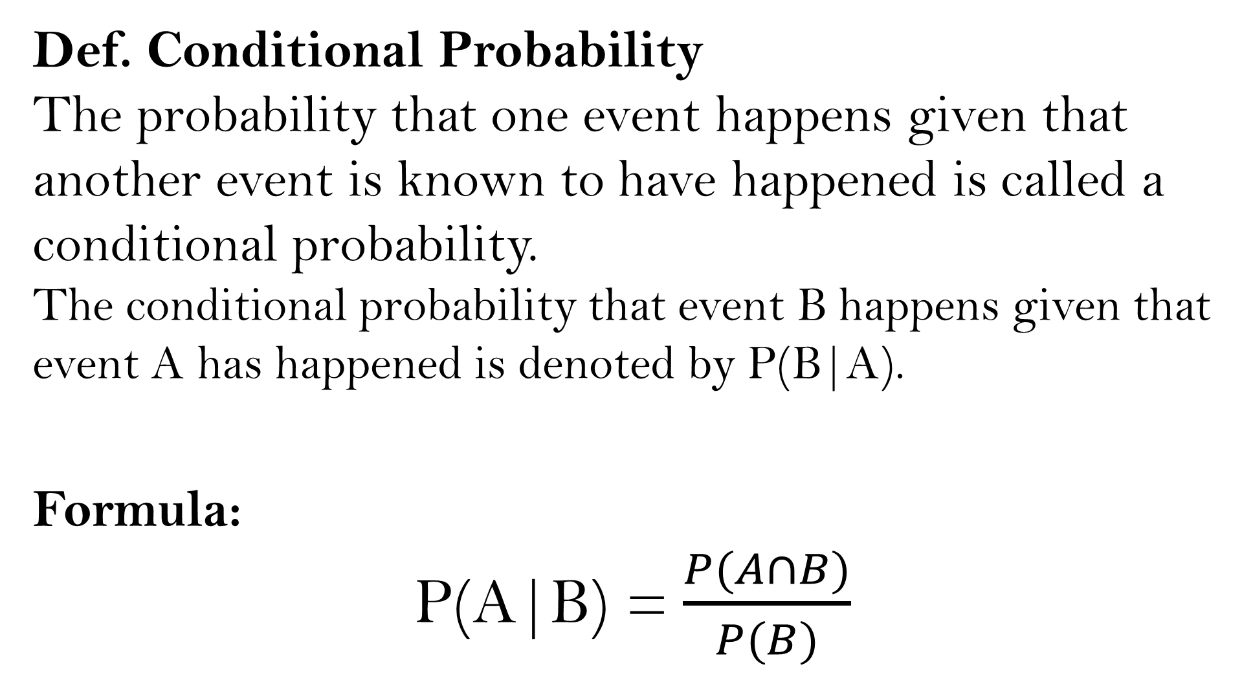
Def. Conditional Probability
The probability that one event happens given that another event is known to have happened is called a conditional probability.
The conditional probability that event B happens given that event A has happened is denoted by P(B|A).
Formula:
P(A|B) =$\frac{P(A∩B)}{P(B)}$

Slide 10
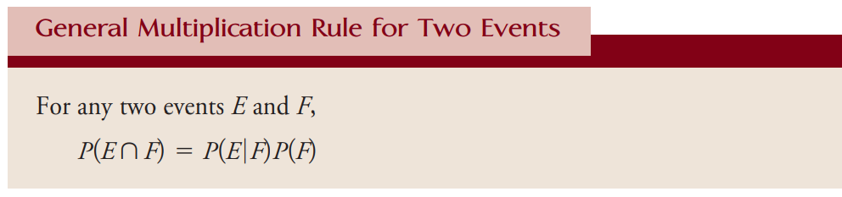
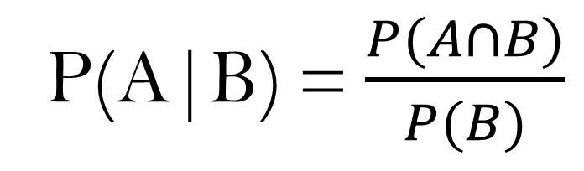
P(A|B) =$\frac{P(A∩B)}{P(B)}$

Slide 11
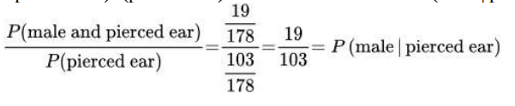
If we know that a randomly selected student has a pierced ear, what is the probability that the student is male?

Slide 12
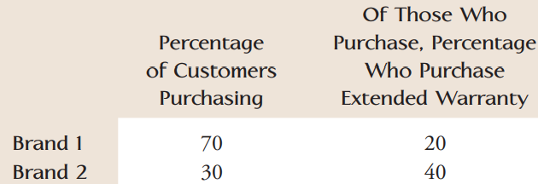
The following table gives information on DVD players sold by a certain electronics store:
A purchaser is randomly selected from among all those who bought a DVD player from the store. What is the probability that the selected customer purchased a Brand 1 model and an extended warranty?

Slide 13
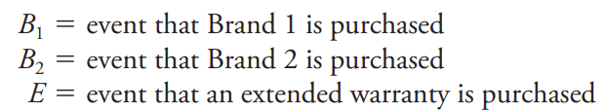

A purchaser is randomly selected from among all those who bought a DVD player from the store. What is the probability that the selected customer purchased a Brand 1 model and an extended warranty?
Define the events as follows.
From the table, we have
Hence, we have the probability that the selected customer purchased a Brand 1 model and an extended warranty is P(B1 and E) = P(E|B1)P(B1)=0.2*0.7=0.14

Slide 14
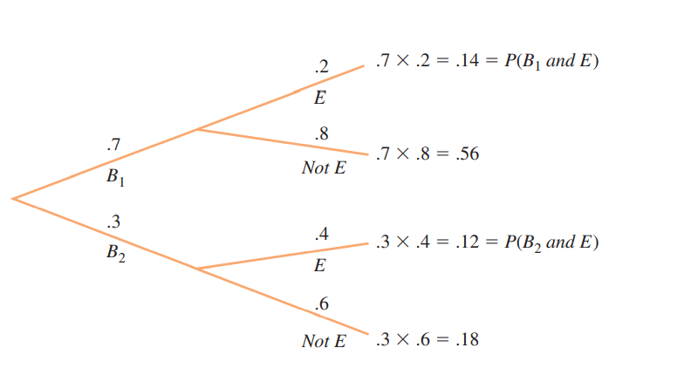
Tree Diagram

Slide 15
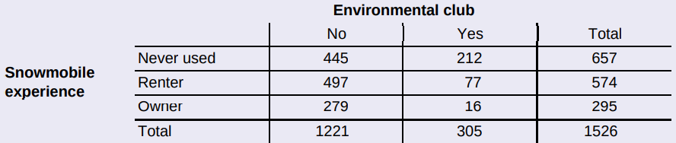
Yellowstone National Park surveyed a random sample of 1526 winter visitors to the park. They asked each person whether he or she owned, rented, or had never used a snowmobile. Respondents were also asked whether they belonged to an environmental organization (like the Sierra Club). The two-way table summarizes the survey responses.
Suppose we randomly select one of the survey respondents.
Define events E: environmental club member, S: snowmobile owner, and N: never used.
Find P(N | E). Interpret this value in context.
Given that the chosen person is not a snowmobile owner, what’s the probability that she or he is an environmental club member? Write your answer as a probability statement using correct symbols for the events.
Is the chosen person more likely to not be an environmental club member if he or she has never used a snowmobile, is a snowmobile owner, or a snowmobile renter? Justify your answer.

Slide 16
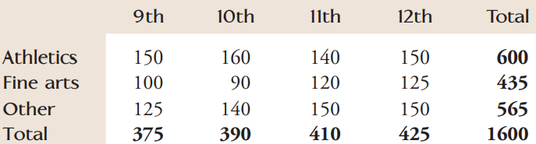

At the fictional George Washington High School (GWHS), after-school activities can be classified into three types: athletics, fine arts, and other. The following table gives the number of students participating in each of these types of activities by grade:
Assume that every student at the school is in exactly one of these after-school activities and that each student is equally likely to be selected. Now, the principal at GWHS selects students at random and invites them to have lunch with her to discuss various issues that might be of concern to them.
P(senior athlete) = ?

Slide 17
At the fictional George Washington High School (GWHS), after-school activities can be classified into three types: athletics, fine arts, and other. The following table gives the number of students participating in each of these types of activities by grade:
Assume that every student at the school is in exactly one of these after-school activities and that each student is equally likely to be selected. Now, the principal at GWHS selects students at random and invites them to have lunch with her to discuss various issues that might be of concern to them.

Slide 18
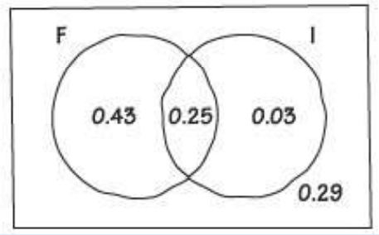
Practice：
A survey of all residents in a large apartment complex reveals that 68% use Facebook, 28% use Instagram, and 25% do both. Suppose we select a resident at random.
Make a Venn diagram to display the sample space of this chance process using the events F: uses Facebook and I: uses Instagram.
Find the probability that the person uses neither Facebook nor Instagram.
Let event A be the event that the person uses neither FB nor Ins.
Then we have P (A) = 0.29.

